Slide 1
Crime in Chicago A Socioeconomic Exploration
Team Spicy Lime
Kanika Bhambi
Lazarus Goosby
Nick Hebert
Greg Rosen

Slide 2
Research Question
What is the relationship between socioeconomic factors
– such as income and education –
and crime in Chicago within the last five years?

Slide 3
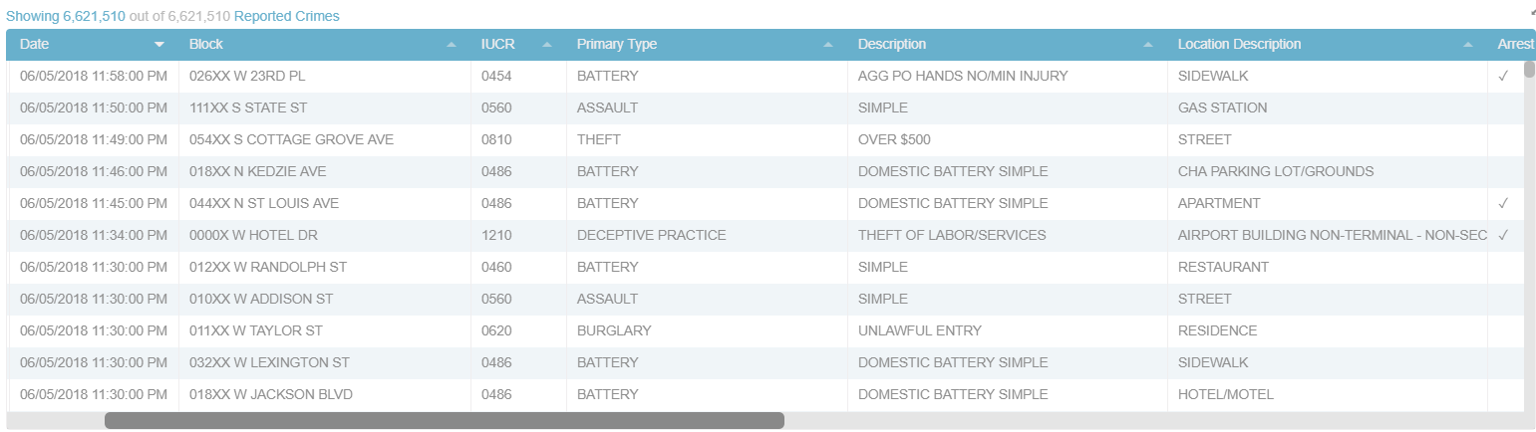
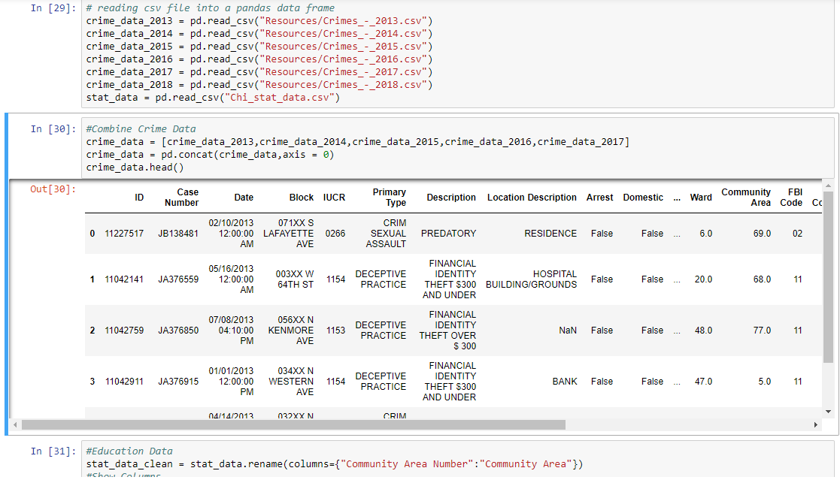
Gathering the Data
City of Chicago Crime Dashboard
2013 - 2017
https://data.cityofchicago.org
Point 2 Homes
2018
https://www.point2homes.com/US/Neighborhood/IL/Chicago.html

Slide 4
Grouping by Neighborhood
χ² test on crimes per capita in Chicago’s 77 neighborhoods
Null Hypothesis
Each neighborhood composed of similar populations
These populations produce the same number of crimes per capita as the city of Chicago
Critical Value
95% confidence with 76 degrees of freedom
97.35
χ² Statistic
Σ (Actual Crimes_{neighborhood} – Expected Crimes_{neighborhood})²
1,701,608.94
p-value
0.0
Conclusion
The neighborhoods are decidedly not composed of similar populations

Slide 5
ANALYSIS
Crime Breakdown

Slide 6
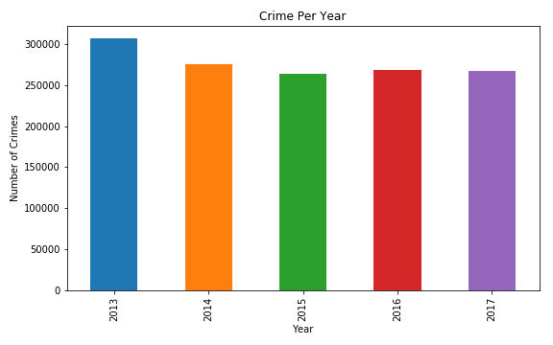
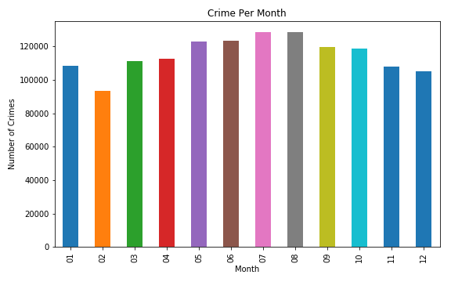
Crime Over Time

Slide 7
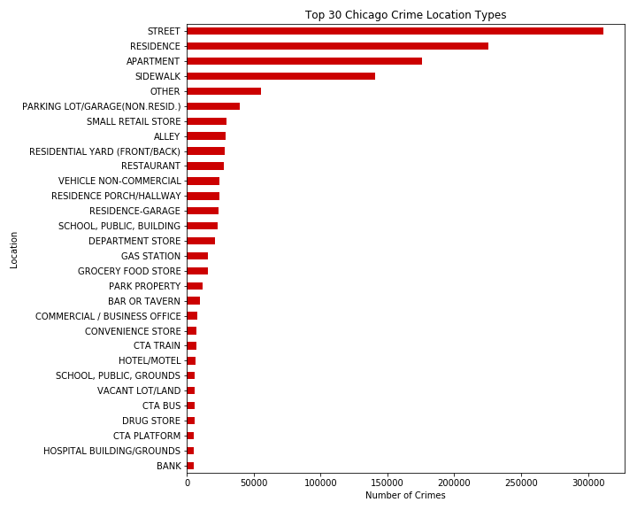
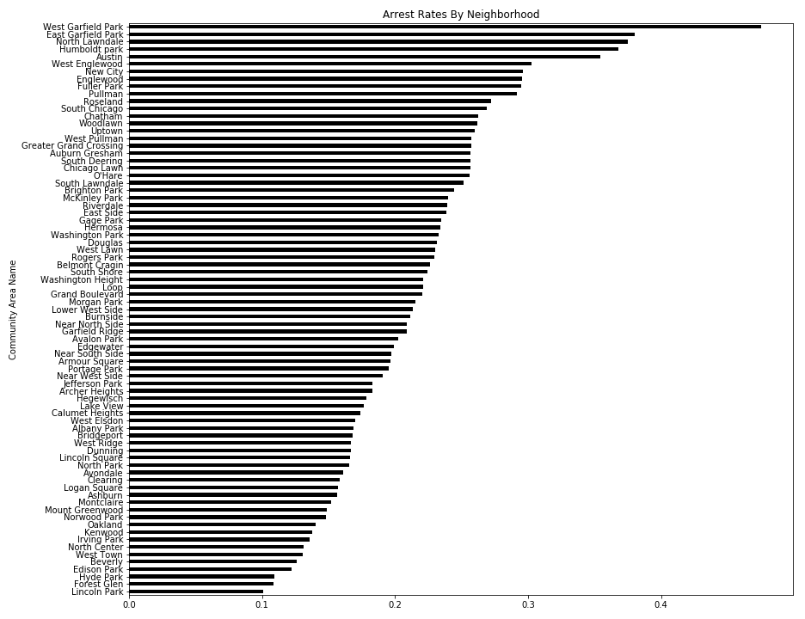
Crime By Location

Slide 8
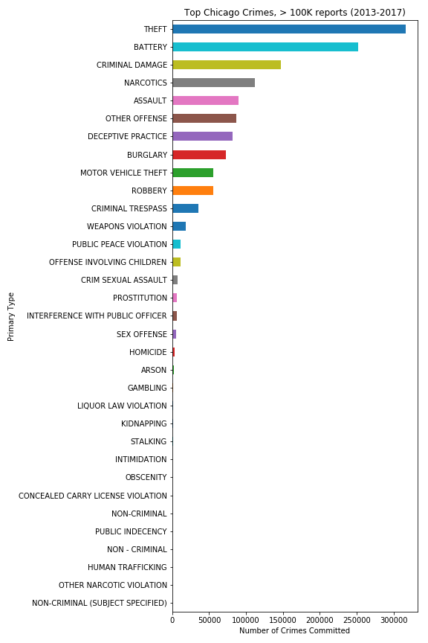
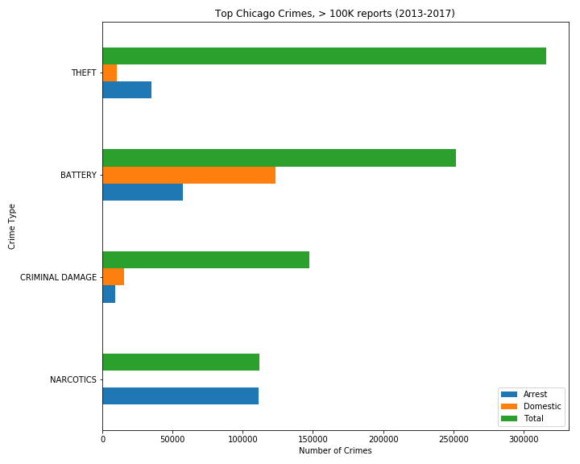
Crime by Type

Slide 9
ANALYSIS
Neighborhood Breakdown

Slide 10
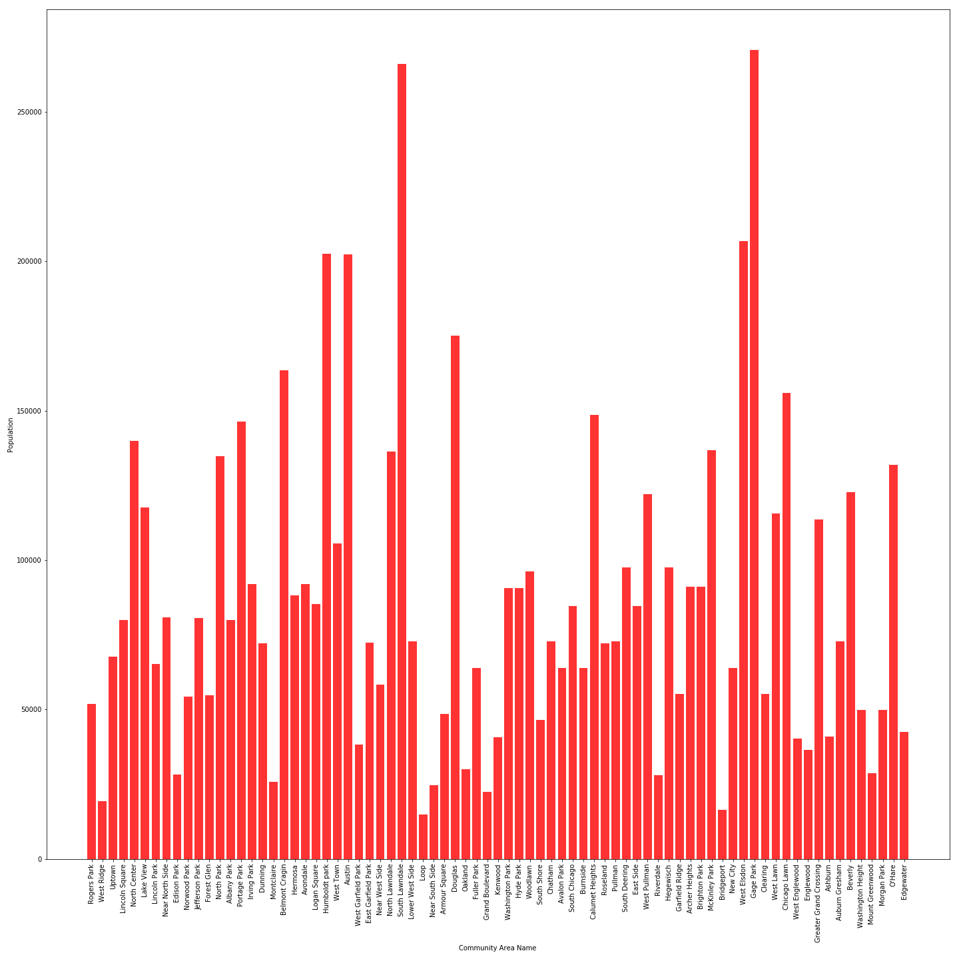
Population

Slide 11
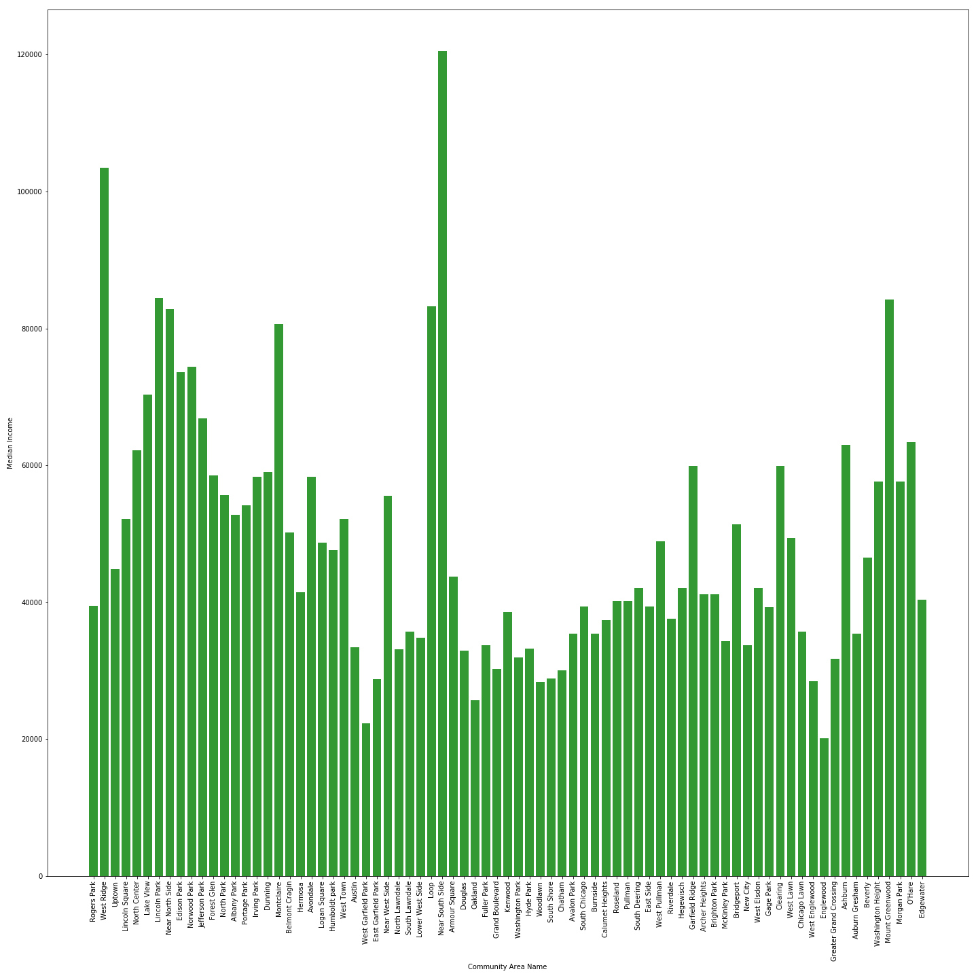
Median
Income

Slide 12
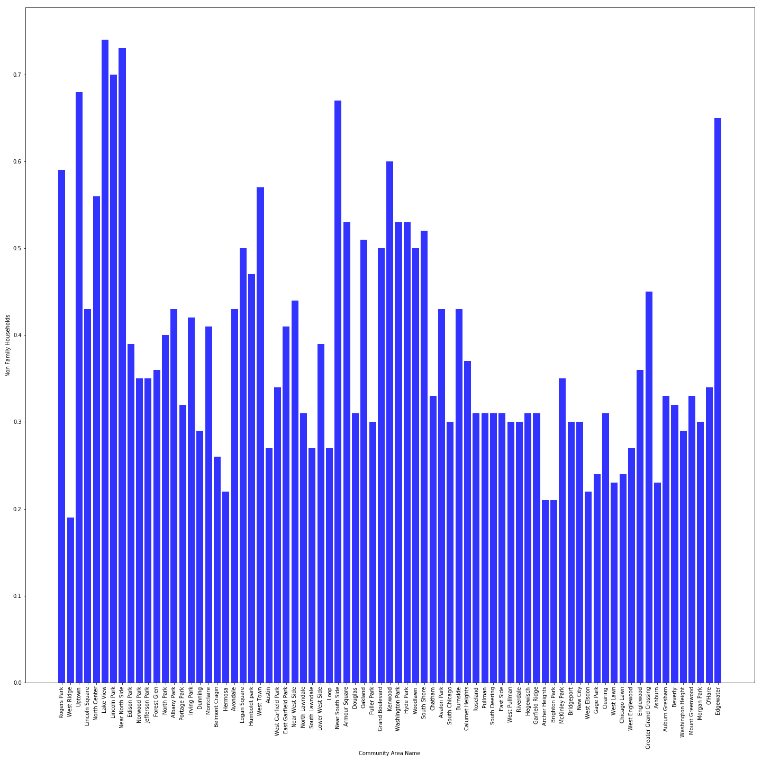
Percentage of Non-Family Households

Slide 13
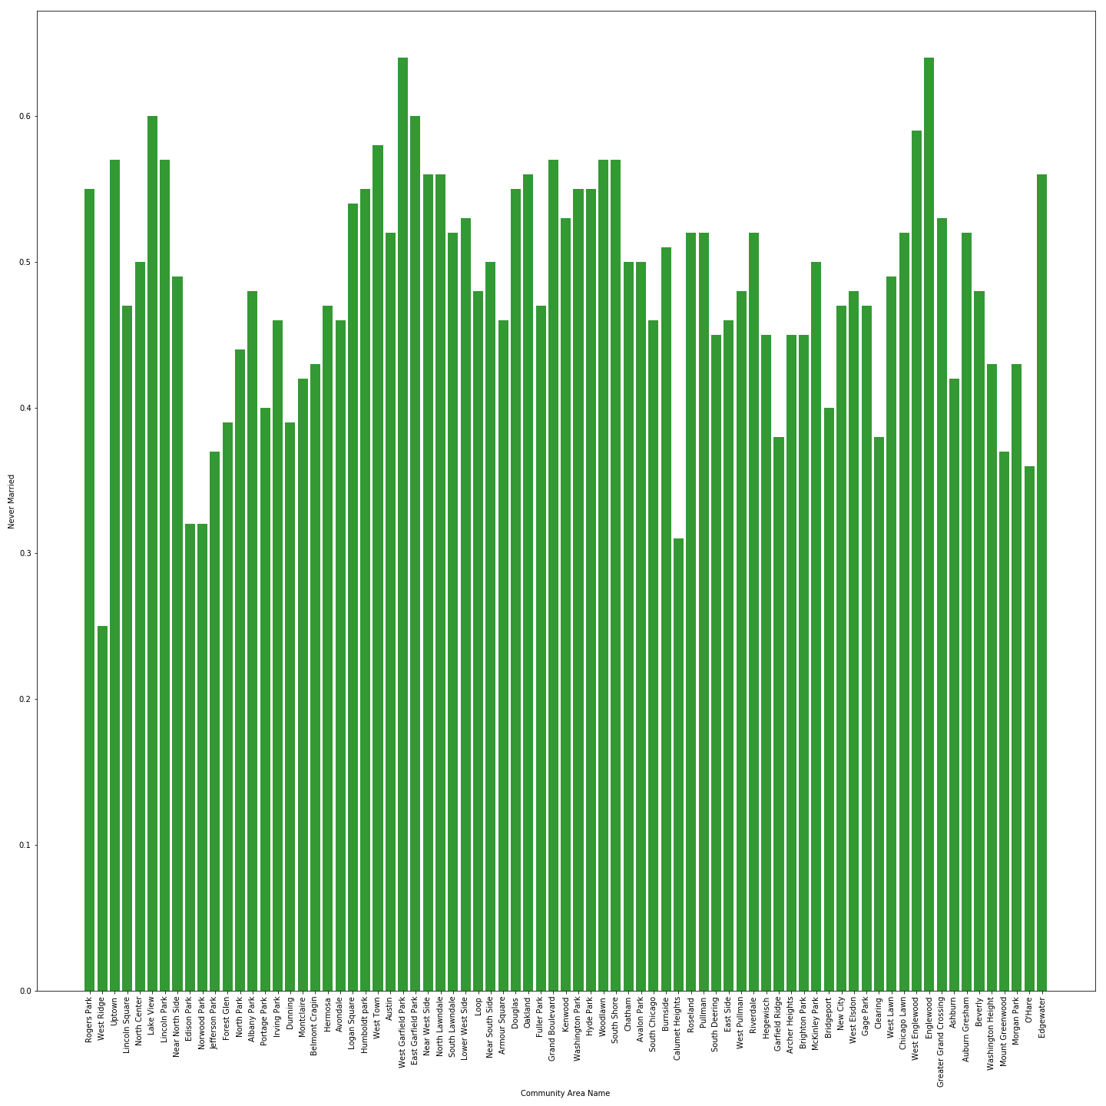
Percentage of Never-Married Residents

Slide 14
ANALYSIS
Statistical Breakdown

Slide 15
Correlations
Population and Number of Arrests
.195
Income and Number of Arrests
-.160
Education and Number of Arrests
-.090
Non Family Households and Number of Arrests
.085
Population and Median Income
-.245
Arrests per Capita and Median Income
.123

Slide 16
Conclusions
As Education and Income increase, Crime and Family Households decrease
We need to dive deeper…

Slide 17
Continued Research
Did we pick accurate metrics of wealth?
Dive deeper into wealth disparity
Are there other factors in education we didn’t account for?
After school activities & proximity to higher education
What types of crimes are correlated with what “kinds” of neighborhoods?
Proprietary data collection
Could our greater service be data collection?

